Slide 1

DEFENCE SERVICES ACADEMY
M.Sc (21st Batch) Computer Science
DEPARTMENT OF COMPUTER SCIENCE
Pyin Oo Lwin
Notes:
Good Afternoon! Honorable and invited guests, all of my Lecturers, supervisor and my batch friends.

Slide 2
Enhancing Real-Time Communication in Learning Management Systems Using WebRTC
Presented by
Captain Myo Min Thu
M . Sc (21st Batch)
Supervisor Lt . Col Myo Thant
Co-supervisor-Major Hein Naing
2
Notes:
Firstly, May I introduce myself.
I'm Captain Myo Min Thu, and Master Candidate at Department of Computer Science.
Today I' would like to present my thesis work.
The title of my thesis is “Enhancing Real-Time Communication in Learning Management Systems Using WebRTC
” .
And my supervisor is Lt Col Myo Thant and Co-supervisor is Major Hein Naing.

Slide 3
Outlines
Abstract
Introduction
Aim of Thesis
Objectives of Thesis
Problem Statement
Background Theories
Conclusion
3
Notes:
OK! First of all, I would like to present outlines of my thesis.
In this seminar, I will present our thesis as these program. And generally divided by 7 state.
First stage is the abstract of our thesis.
Second stage is the Introduction of our thesis.
Third stage is the Aim of our thesis.
Fourth stage is the Objectives of our thesis.
Fifth is the Problem Statement .
Sixth is the background theory.
Finally, is the conclusion of our thesis.

Slide 4
Abstract
The advent of digital learning environments has necessitated the development of robust communication tools to facilitate effective interaction between learners and educators.
This thesis explores the integration of Web Real-Time Communication (WebRTC) into Learning Management Systems (LMS) to enhance real-time communication features such as video conferencing, voice calls, and screen sharing.
The study aims to design, implement, and evaluate a WebRTC-based communication module within an existing LMS.
4
Notes:
In this slides, May I present about the abstract of my thesis.

Slide 5
Introduction
The advent of digital technologies has revolutionized the educational landscape, leading to the widespread adoption of Learning Management Systems (LMS) in both academic and corporate settings.
Web Real-Time Communication (WebRTC) is an open-source project that provides web applications and websites with real-time communication capabilities via simple application programming interfaces (APIs).
The theoretical framework for this research is grounded in the constructivist learning theory and media richness theory.
5
Notes:
Now I would like to present the introduction of system.
ဒီဂျစ်တယ်နည်းပညာများ၏ရောက်ရှိမှုသည် ပညာရေးလုပ်ငန်းပုံစံကို ပြောင်းလဲစေပြီး သင်ယူမှုစီမံခန့်ခွဲမှုစနစ်များ (LMS) ကို ပညာရေးနှင့် ကော်ပိုရေးရှင်းဆိုင်ရာ လုပ်ငန်းခွင်များတွင် ကျယ်ကျယ်ပြန့်ပြန့်အသုံးပြုလာစေသည်။ Web Real-Time Communication (WebRTC) သည် ရိုးရှင်းသော အပလီကေးရှင်း ပရိုဂရမ်မင်း အင်တာဖေ့စ်များ (APIs) မှတစ်ဆင့် ဝဘ်အပလီကေးရှင်းများနှင့် ဝဘ်ဆိုက်များကို အချိန်နှင့်တပြေးညီ ဆက်သွယ်ရေးစွမ်းဆောင်ရည်များ ပေးစွမ်းသော ဖွင့်လှစ်အရင်းအမြစ် (open-source) စီမံကိန်းတစ်ခု ဖြစ်သည်။ ဤသုတေသန၏ သီအိုရီကိုအခြေပြုမြင်ကွင်းမှာ တည်ဆောက်ရေးသင်ယူမှု သီအိုရီနှင့် မီဒီယာပျံ့နှံ့မှု သီအိုရီတို့ ပေါ်မှာ မူတည်သည်။

Slide 6
Aim of my thesis
The primary aim of this thesis is to enhance real-time communication within Learning Management Systems (LMS) by integrating Web Real-Time Communication (WebRTC) technology. The goal is to facilitate improved synchronous learning experiences, fostering greater interaction, engagement, and collaboration among users, ultimately leading to better educational outcomes.
6
Notes:
Now I would like to present the introduction of system.
ဤသုတေသန၏ မူလရည်ရွယ်ချက်မှာ Web Real-Time Communication (WebRTC) နည်းပညာကို ပေါင်းစပ်ခြင်းဖြင့် သင်ယူမှုစီမံခန့်ခွဲမှုစနစ်များ (LMS) အတွင်း အချိန်နှင့်တပြေးညီ ဆက်သွယ်ရေးကို တိုးတက်စေရန်ဖြစ်သည်။ ၎င်းရည်ရွယ်ချက်မှာ သင်ယူမှုအတွေ့အကြုံများကို တိုးတက်စေရန်၊ သင်ယူသူများအကြား ပိုမိုသော အပြန်အလှန်ဆက်သွယ်မှု၊ တက်ကြွမှုနှင့် ပူးပေါင်းဆောင်ရွက်မှုတို့ကို မြှင့်တင်ပေးပြီး ပညာရေးရလဒ်များကို ပိုမိုကောင်းမွန်စေရန်ဖြစ်သည်။

Slide 7
Objectives
To implement key features such as video conferencing, voice calls, and screen sharing to support real-time communication and collaboration.
To perform functional testing for addressing potential issues related to compatibility, reliability, and usability.
To conduct a thorough review of current communication tools integrated to identify their strengths and limitations.
To perform comprehensive usability testing with educators and students to assess the effectiveness, ease of use, and reliability of the WebRTC communication module.
7
Notes:
And then I would like to present the objectives of our thesis.

Slide 8
Problem Statement
Assess the limitations of current communication tools within LMS platforms that affect real-time interaction and engagement.
Explore the integration of WebRTC technology into LMS platforms to enhance synchronous communication features, including video conferencing, voice calls, and screen sharing.
Evaluate the impact of WebRTC integration on user engagement, system performance, and educational outcomes in a real-world educational setting.
8
Notes:
And then I would like to present the problem statement of system. လက်ရှိ LMS ပလက်ဖောင်းများအတွင်းရှိ ဆက်သွယ်ရေးကိရိယာများ၏ ကန့်သတ်ချက်များကို ခန့်မှန်းပြီး အချိန်နှင့်တပြေးညီ အပြန်အလှန်ဆက်သွယ်မှုနှင့် တက်ကြွမှုများကို ထိခိုက်စေသော အကြောင်းရင်းများကို အကဲဖြတ်ရန်။ WebRTC နည်းပညာကို LMS ပလက်ဖောင်းများအတွင်း ပေါင်းစပ်၍ ဗီဒီယို ဆွေးနွေးပွဲများ၊ အသံခေါ်ဆိုမှုများနှင့် နေ့စဉ်မျက်နှာစာမျှဝေမှုများအပါအဝင် အချိန်နှင့်တပြေးညီ ဆက်သွယ်ရေးအင်္ဂါရပ်များကို တိုးတက်စေရန် ရှာဖွေစူးစမ်းရန်။ တကယ့်လောကပညာရေးအခြေအနေတွင် အသုံးပြုသူများ၏ တက်ကြွမှု၊ စနစ်စွမ်းဆောင်ရည်နှင့် ပညာရေးရလဒ်များပေါ်တွင် WebRTC ပေါင်းစပ်မှု၏ သက်ရောက်မှုကို အကဲဖြတ်ရန်။

Slide 9
Background Theory
Web Application Architecture
Learning Management System (LMS)
Web Real-Time Communication
Web Server
Hyper Text Transfer Protocol (HTTP)
Hypertext Markup Language (HTML)
Cascading Style Sheets (CSS)
Personal Home Page or Hypertext Preprocessor (PHP)
Relational Database Management System (RDBMS)
MySQL Database Server
9
Notes:
In this slide, I would like to explore the history of web services, which were introduced in the late 1990s to facilitate communication between software applications over the internet.
Early web services used SOAP and XML for data exchange.
However, in the mid-2000s, the REST architectural style emerged as an alternative to SOAP-based web services. RESTful APIs offer a simpler and more lightweight approach to building APIs.
Today, web services play a critical role in enabling the integration of different software systems and applications.

Slide 10
Web Application Architecture
Web application architecture describes the relationships between databases, servers, and applications in a system. Below is a general overview of key components and considerations in web application architecture-
Client-Side (Frontend)
Server-Side (Backend)
Database Management System (DBMS)
Application Programming Interface (API)
10
Notes:
In this slide, I would like to explore the history of web services, which were introduced in the late 1990s to facilitate communication between software applications over the internet.
Early web services used SOAP and XML for data exchange.
However, in the mid-2000s, the REST architectural style emerged as an alternative to SOAP-based web services. RESTful APIs offer a simpler and more lightweight approach to building APIs.
Today, web services play a critical role in enabling the integration of different software systems and applications.

Slide 11
Client-Side(Frontend)
The client-side, also known as the frontend, is the part of a website that users interact with directly.
User Interface (UI): HTML (Hypertext Markup Language), CSS (Cascading Style Sheets), JavaScript
Web Browser: Google Chrome, Mozilla Firefox, Safari, Microsoft Edge, etc.
Frameworks and Libraries:
React, Angular, Vue.js
Bootstrap, Materialize CSS
AJAX (Asynchronous JavaScript and XML)
11
Notes:
In this slide, I would like to explore the history of web services, which were introduced in the late 1990s to facilitate communication between software applications over the internet.
Early web services used SOAP and XML for data exchange.
However, in the mid-2000s, the REST architectural style emerged as an alternative to SOAP-based web services. RESTful APIs offer a simpler and more lightweight approach to building APIs.
Today, web services play a critical role in enabling the integration of different software systems and applications.

Slide 12
Server-Side(Backend)
The server-side, or backend, of a website is responsible for handling tasks that don't involve direct interaction with the user but are crucial for the functionality and data management of the application.
Web Server: Apache, Nginx, Microsoft IIS
Database: MySQL, PostgreSQL, MongoDB, SQLite, Oracle
API (Application Programming Interface)
Middleware
Authentication and Authorization
Server-Side Languages: PHP, JavaScript(JS),Python etc.
12
Notes:
In this slide, I would like to explore the history of web services, which were introduced in the late 1990s to facilitate communication between software applications over the internet.
Early web services used SOAP and XML for data exchange.
However, in the mid-2000s, the REST architectural style emerged as an alternative to SOAP-based web services. RESTful APIs offer a simpler and more lightweight approach to building APIs.
Today, web services play a critical role in enabling the integration of different software systems and applications.

Slide 13
Learning Management System
A learning management system is a software application or web-based technology used to plan, implement and assess a specific learning process. It's used for e-learning practices and, in its most common form, consists of two elements: a server that performs the base functionality and a user interface (UI) that is operated by instructors, students and administrators.
Typically, an LMS provides an instructor with a way to create and deliver content, monitor student participation, and assess student performance. It might also provide students with interactive features, such as threaded discussions, video conferencing and discussion forums.
13
Notes:
LMS ဆိုတာ သင်ကြားရေး အစီအစဉ်တွေ နဲ့ ပတ်သက်ပြီး စီမံခန့်ခွဲမှု၊ မှတ်တမ်းပြုစုခြင်း၊ လုပ်ဆောင်မှု ခြေရာခံခြင်း၊ အစီရင်ခံစာပြုစုခြင်း နဲ့ သင်ကြားမှုတွေ တင်သွင်းခြင်း စတာတွေကို ကူညီပေးတဲ့ ဆော့ဖ်ဝဲ ပလက်ဖောင်း ဖြစ်ပါတယ်။ Moodle, Blackboard, Canvas တို့လို ပလက်ဖောင်းတွေ ပါဝင်ပါတယ်။ ဒါတွေမှာ သင်တန်းဖွဲ့စည်းမှု၊ စစ်ဆေးမှု၊ အသုံးပြုသူ စီမံခန့်ခွဲမှု စတာတွေ ပါဝင်ပါတယ်။

Slide 14
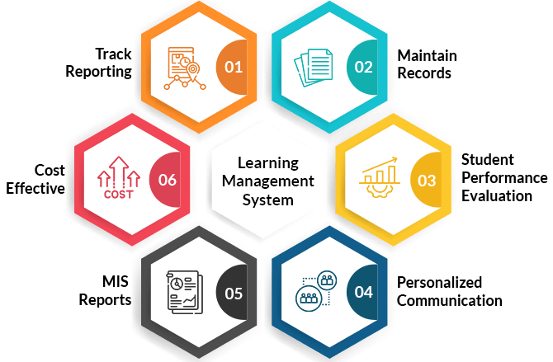
Used of Learning management System (LMS)
Onboarding and training
Development and retention
Sales training
Blended learning
14
Notes:
In this slide, I would like to explore the history of web services, which were introduced in the late 1990s to facilitate communication between software applications over the internet.
Early web services used SOAP and XML for data exchange.
However, in the mid-2000s, the REST architectural style emerged as an alternative to SOAP-based web services. RESTful APIs offer a simpler and more lightweight approach to building APIs.
Today, web services play a critical role in enabling the integration of different software systems and applications.

Slide 15
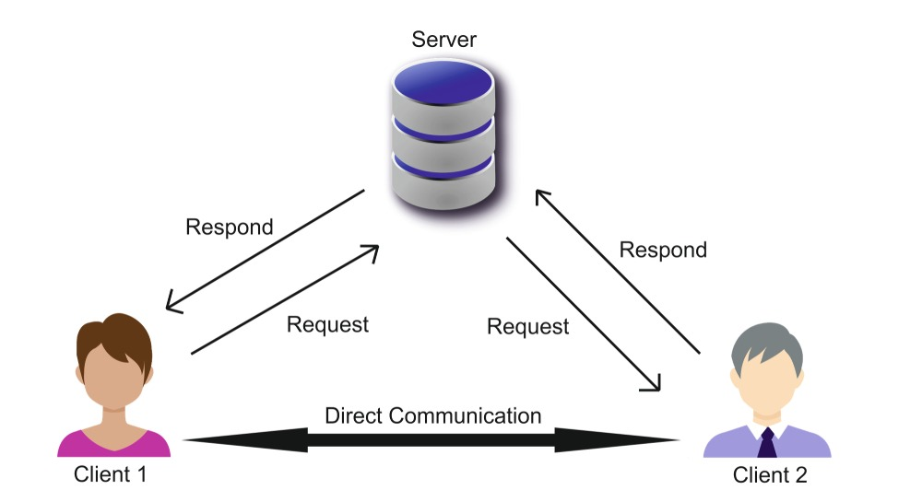
WebRTC (Web Real-Time Communication) is a free and open-source project providing web browsers and mobile applications with real-time communication (RTC) via application programming interfaces (APIs). It allows audio and video communication and streaming to work inside web pages by allowing direct peer-to-peer communication, eliminating the need to install plugins or download native apps.
Web Real-Time Communication
15
Notes:
WebRTC (Web Real-Time Communication) ဆိုတာ ဘယ်နေရာမှာမဆို အသုံးပြုနိုင်တဲ့ ပလက်ဖောင်းဖြစ်ပြီး၊ အသုံးပြုသူတွေ အကြားမှာ အချိန်နာရီချိန် ကွန်ယူနိကေးရှင်း ပေးနိုင်စွမ်းရှိပါတယ်။ WebRTC က ပလက်ဂင်း (plugin) သို့မဟုတ် ထပ်ဆင့်ဆော့ဖ်ဝဲမလိုအပ်ပဲ အသုံးပြုနိုင်တာမို့ အသုံးပြုရ လွယ်ကူပါတယ်။

Slide 16
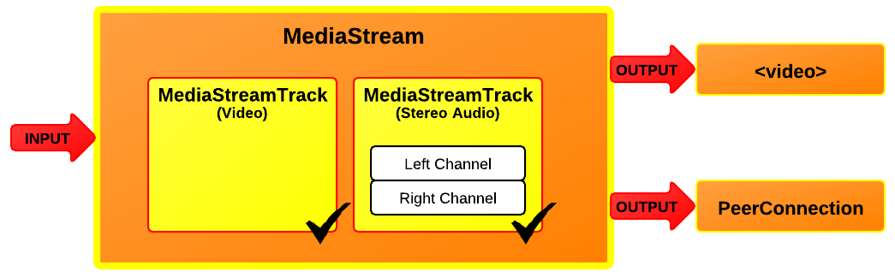
MediaStream (getUserMedia)
MediaStream (getUserMedia) is a fundamental API in Web Real-Time Communication (WebRTC) that enables web applications to access media devices, such as cameras and microphones, to capture audio and video streams directly from the user's device. This API is critical for creating interactive and engaging applications that require real-time media capture, such as video conferencing, online gaming, and virtual classrooms.
16
Notes:
MediaStream (getUserMedia) သည် အသုံးပြုသူ၏ စက်မှ အသံနှင့် ဗီဒီယို ထုတ်လွှင့်မှုများကို တိုက်ရိုက်ဖမ်းယူရန် ဝဘ်အပလီကေးရှင်းများဖြစ်သည့် ကင်မရာများနှင့် မိုက်ခရိုဖုန်းများကဲ့သို့ မီဒီယာကိရိယာများကို ဝင်ရောက်ကြည့်ရှုနိုင်စေသည့် ဝဘ်အချိန်နှင့်တပြေးညီ ဆက်သွယ်ရေး (WebRTC) ရှိ အခြေခံ API တစ်ခုဖြစ်သည်။

Slide 17
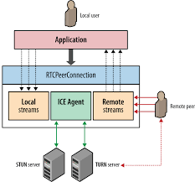
RTCPeerConnection
RTCPeerConnection is a core component of the Web Real-Time Communication (WebRTC) API, enabling real-time audio, video, and data exchange between browsers or applications. It provides a standardized interface for establishing peer-to-peer connections, allowing developers to build applications such as video conferencing, file sharing, and online gaming with high-quality, low-latency communication.
17
Notes:
RTCPeerConnection သည် ဘရောက်ဆာများ သို့မဟုတ် အပလီကေးရှင်းများအကြား အချိန်နှင့်တစ်ပြေးညီ အော်ဒီယို၊ ဗီဒီယိုနှင့် ဒေတာဖလှယ်မှုကို လုပ်ဆောင်ပေးသည့် Web Real-Time Communication (WebRTC) API ၏ အဓိကအစိတ်အပိုင်းတစ်ခုဖြစ်သည်။ ၎င်းသည် ဆော့ဖ်ဝဲအင်ဂျင်နီယာများအား ဗီဒီယိုကွန်ဖရင့်၊ ဖိုင်မျှဝေခြင်းနှင့် အွန်လိုင်းဂိမ်းကစားခြင်းကဲ့သို့သော အရည်အသွေးမြင့်၊ latency နည်းပါးသော ဆက်သွယ်ရေးဖြင့် အပလီကေးရှင်းများတည်ဆောက်နိုင်စေမည့် ရွယ်တူအချင်းချင်းချိတ်ဆက်မှုများကို တည်ထောင်ရန်အတွက် စံသတ်မှတ်ထားသော အင်တာဖေ့စ်ကို ပံ့ပိုးပေးပါသည်။

Slide 18
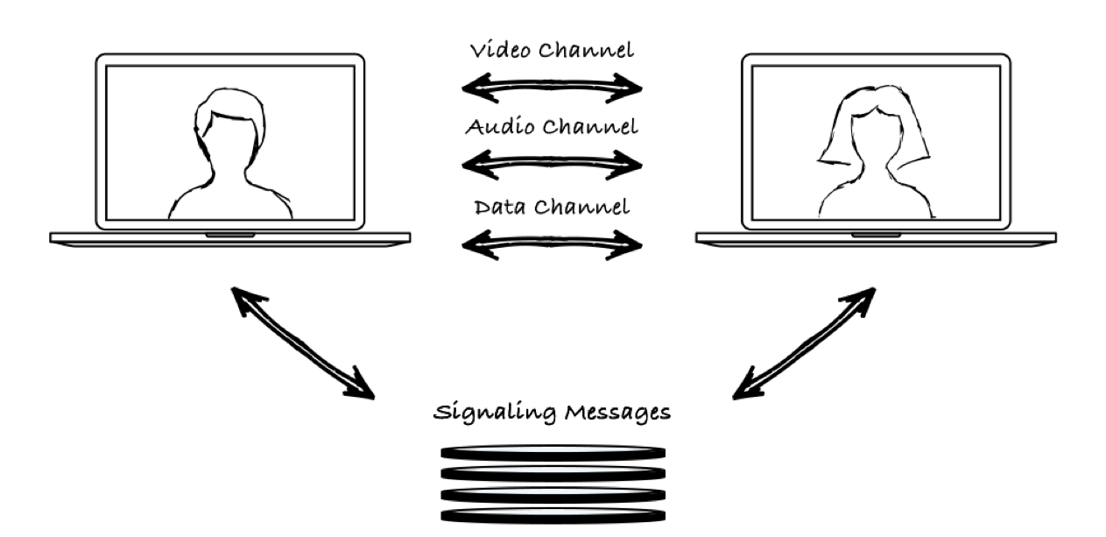
RTCDataChannel
RTCDataChannel is a key component of the Web Real-Time Communication (WebRTC) API, providing a mechanism for bi-directional, peer-to-peer data transfer between web browsers or applications. This API allows for the transmission of arbitrary data, making it suitable for a wide range of applications such as file sharing, real-time gaming, chat applications, and collaborative tools.
18
Notes:
In this slide, I would like to explore the history of web services, which were introduced in the late 1990s to facilitate communication between software applications over the internet.
Early web services used SOAP and XML for data exchange.
However, in the mid-2000s, the REST architectural style emerged as an alternative to SOAP-based web services. RESTful APIs offer a simpler and more lightweight approach to building APIs.
Today, web services play a critical role in enabling the integration of different software systems and applications.

Slide 19
Web Server
A web server is a software application that stores, processes, and delivers web content to users over the internet.
It handles HTTP requests, serving static content such as HTML, images, and stylesheets, and processes dynamic content using server-side scripting languages.
Web servers play a vital role in hosting websites, facilitating user access, and managing data interactions with databases.
Popular web server software includes Apache, Nginx, and Microsoft IIS, contributing to the foundational infrastructure of the World Wide Web.
19
Notes:
Web Server ဆိုတာက အင်တာနက်ပေါ်မှာ Website တွေ၊ Application တွေကို Host လုပ်ပြီး အသုံးပြုသူ (User) တွေက Request လုပ်တဲ့ Data တွေကို Response ပေးတဲ့ Server တစ်ခုဖြစ်ပါတယ်။ Web Server သည် HTTP (Hypertext Transfer Protocol) သို့မဟုတ် HTTPS Protocol ကို အသုံးပြုသည့် Client (အတူတူသော Browser, Mobile App) နှင့် ဆက်သွယ်ပြီး Data (HTML, CSS, JS, Images, Videos, API Data) ပေးပို့ပါတယ်။

Slide 20
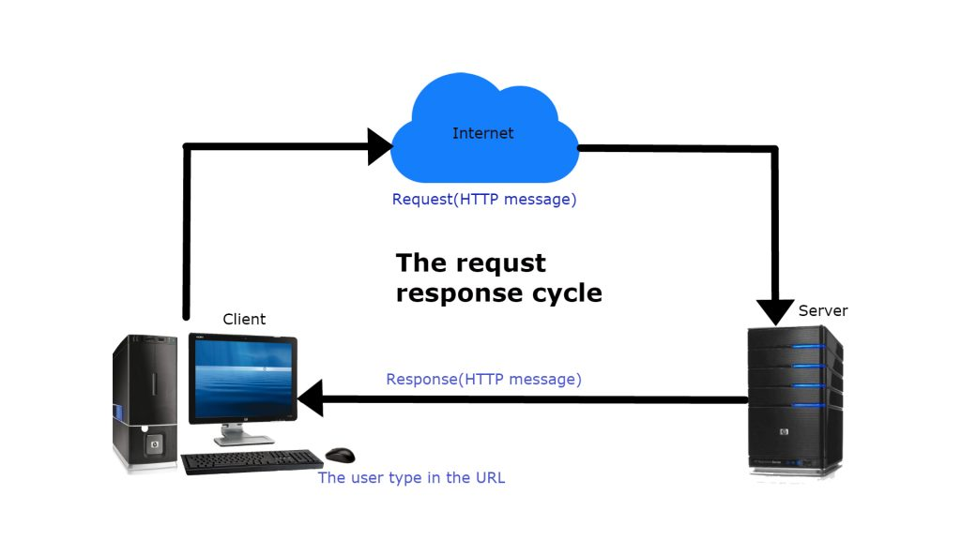
Hypertext Transfer Protocol (HTTP)
HTTP stands for Hypertext Transfer Protocol. It is the foundation of data communication on the World Wide Web. When you access a website through your web browser, the browser sends an HTTP request to the web server hosting the website. The web server processes the request and sends back the requested web page or other resources, such as images or scripts, using HTTP.
20
Notes:
Hypertext Transfer Protocol (HTTP) ဆိုတာက အင်တာနက်ပေါ်မှာ Data (Text, Images, Videos, etc.) တွေကို Browser နှင့် Server တို့အကြား ရှေးရောက်စေဖို့ အသုံးပြုတဲ့ Protocol တစ်ခုဖြစ်ပါတယ်။

Slide 21
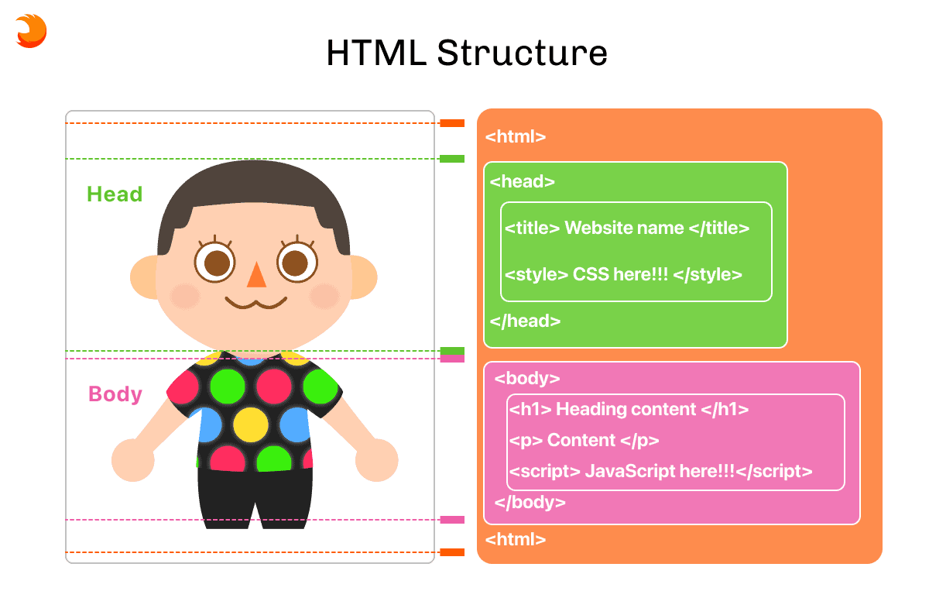
Hypertext Markup Language (HTML)
HTML (Hypertext Markup Language) is the standard language for creating web pages. It uses tags to structure content, defining elements like headings, paragraphs, images, links, and more. These tags enclose content, providing instructions to web browsers on how to display information, allowing for the creation of visually engaging and interactive web pages.
21
Notes:
HTML ဆိုတာ Website တွေကို ဖန်တီးဖို့ အသုံးပြုတဲ့ Markup Language တစ်ခုဖြစ်ပါတယ်။
HTML သည် Web Page ရဲ့ Structure (ပုံစံ) ကို သတ်မှတ်ပေးပြီး Browser တွေက HTML Code ကိုဖတ်ရှုပြီး User Interface (UI) အဖြစ်ပြသပေးပါသည်။

Slide 22
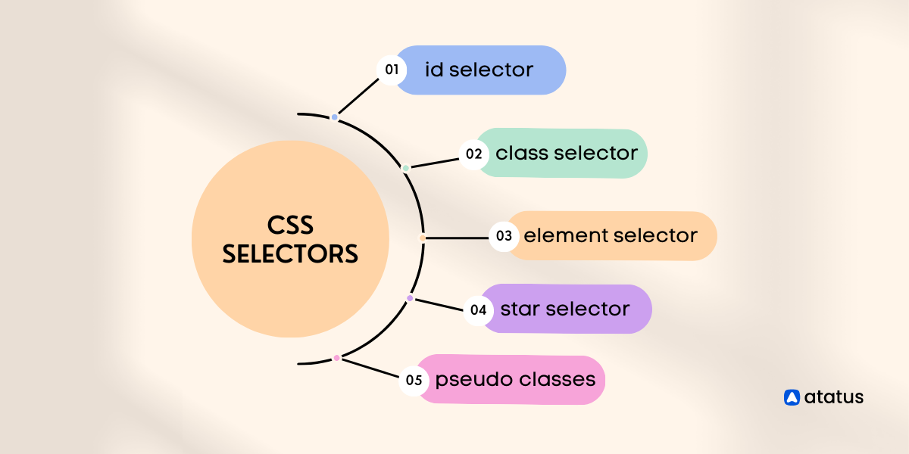
CSS (Cascading Style Sheets)
HTML (Hypertext Markup Language) is the standard language for creating web pages. It uses tags to structure content, defining elements like headings, paragraphs, images, links, and more. These tags enclose content, providing instructions to web browsers on how to display information, allowing for the creation of visually engaging and interactive web pages.
22
Notes:
In this slide, I would like to explore the history of web services, which were introduced in the late 1990s to facilitate communication between software applications over the internet.
Early web services used SOAP and XML for data exchange.
However, in the mid-2000s, the REST architectural style emerged as an alternative to SOAP-based web services. RESTful APIs offer a simpler and more lightweight approach to building APIs.
Today, web services play a critical role in enabling the integration of different software systems and applications.

Slide 23
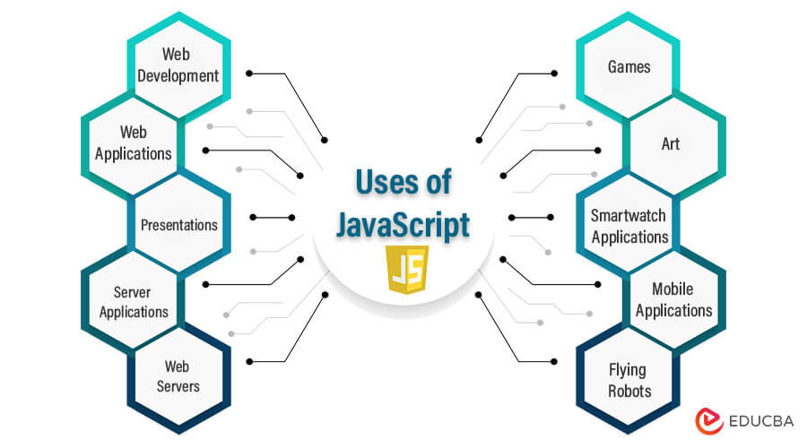
JavaScript(JS)
JavaScript is a versatile programming language primarily used for web development. It enables interactive and dynamic features on websites, allowing manipulation of webpage content, handling user interactions, and creating responsive, engaging experiences. JavaScript is executed by web browsers and supports both front-end and back-end development through frameworks like Node.js.
23
Notes:
In this slide, I would like to explore the history of web services, which were introduced in the late 1990s to facilitate communication between software applications over the internet.
Early web services used SOAP and XML for data exchange.
However, in the mid-2000s, the REST architectural style emerged as an alternative to SOAP-based web services. RESTful APIs offer a simpler and more lightweight approach to building APIs.
Today, web services play a critical role in enabling the integration of different software systems and applications.

Slide 24
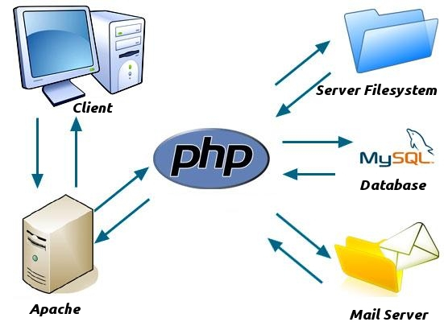
Hypertext Preprocessor (PHP)
PHP (Hypertext Preprocessor) is a server-side scripting language for web development. It’s used to create dynamic web pages by embedding code within HTML. PHP handles tasks such as database interactions, form submissions, and content generation, making it popular for building robust web applications and powering websites with versatile functionality.
24
Notes:
PHP (Hypertext Preprocessor) ဆိုတာက Server-Side Scripting Language တစ်ခုဖြစ်ပြီး Dynamic Website တွေနဲ့ Web Applications ဖန်တီးဖို့အတွက် အသုံးပြုရပါတယ်။ PHP ဟာ Backend Development အတွက် အသုံးများပြီး HTML, CSS, JavaScript တို့နဲ့ အလွယ်တကူ ပေါင်းစပ်အသုံးပြုနိုင်ပါတယ်။2. PHP ကို Windows, macOS, Linux စတဲ့ Operating Systems များတွင် အသုံးပြုနိုင်သည်။3, PHP ဟာ အခမဲ့ဖြစ်ပြီး Source Code ကို Customize လုပ်နိုင်ပါတယ်။

Slide 25
Relational Database Management System
Transfer)
A relational database (RDB) is a collective set of multiple data sets organized by tables, records and columns.
RDBs use Structured Query Language (SQL), which is a standard user application that provides an easy programming interface for database interaction.
These are classified as follows:
One to One: One table record relates to another record in another table.
One to Many: One table record relates to many records in another table.
Many to One: More than one table record relates to another table record.
Many to Many: More than one table record relates to more than one record in another table.
25

Slide 26
MySQL
Transfer)
MySQL is one of the most popular open-source relational database management systems (RDBMS).
Invented and originally developed by Finish developer Michael Widenus, also known as Monty, MySQL was initially released on May 23, 1995, and sold to Sun Microsystems (now Oracle) in 2008.
MySQL has a large and active open-source community, which means there is a wealth of resources, tutorials, and forums available for assistance.
26

Slide 27
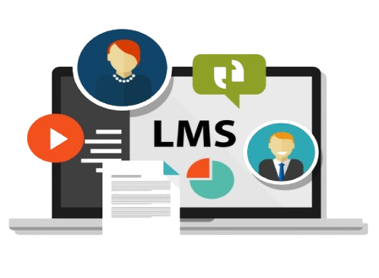
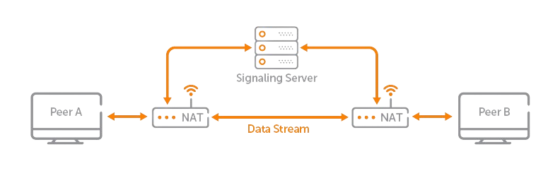
Proposed System Design
Transfer)
27

Slide 28
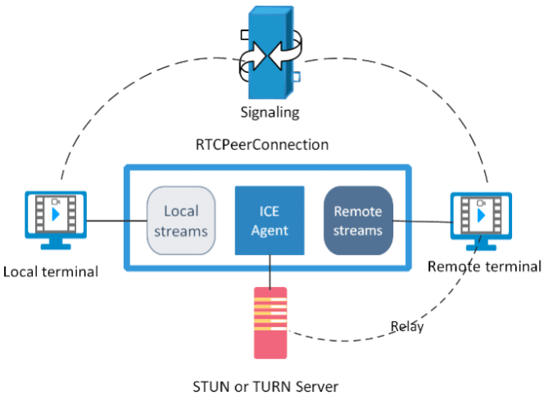
Proposed System Design of WebRTC
Transfer)
27

Slide 29
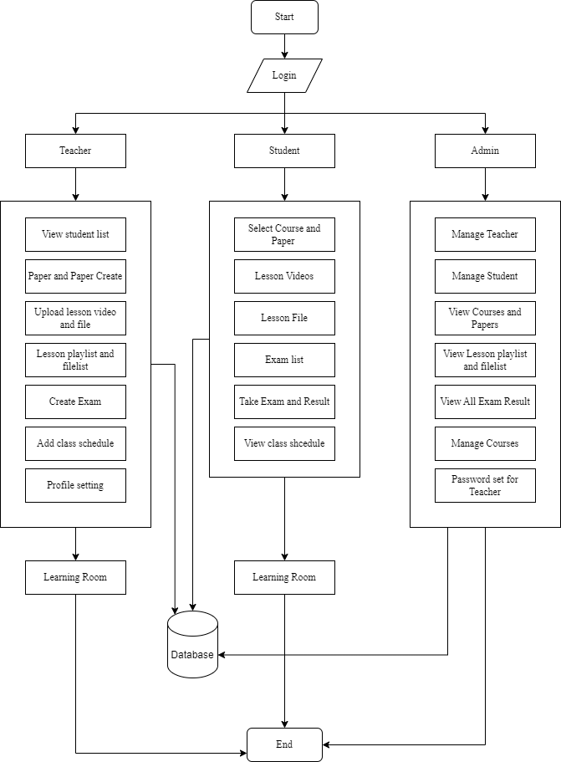
Overall System Design
Transfer)
27

Slide 30
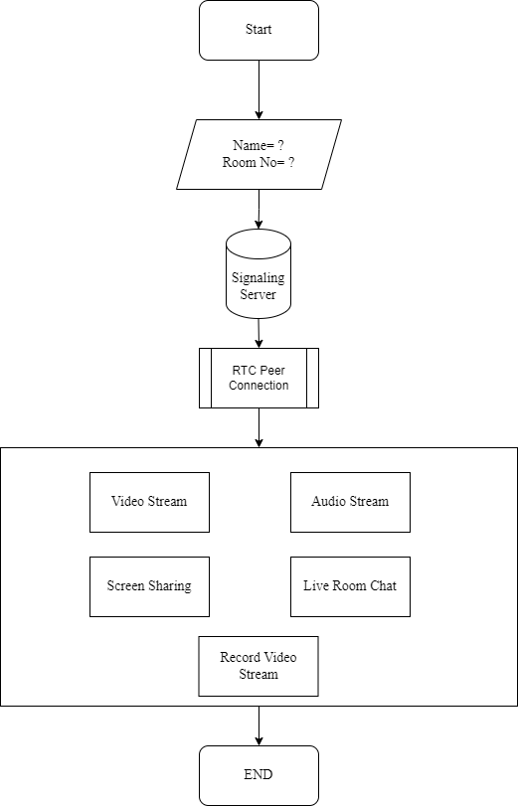
Detail Design of Learning Room
27

Slide 31
Conclusion
This system supports an Automated Military Tactical Support System, designed to leverage advancements in Geospatial Information Systems (GIS) and algorithmic optimization to provide dynamic visualizations of weapon firing ranges and comprehensive engagement planning.
It also supports to automate the process of retrieving location data, measuring distances, visualizing weapon ranges, and calculating optimal engagement strategies, thereby providing military personnel with a robust tool for more precise and effective decision-making.
28

Slide 32
Any Suggestions?

Slide 33
Thank You
Notes:
Thank you for your kind attention.

